Slide 1
Tel: 01017776756 - 01501827070
E-mail: sherrost@yahoo.com
section 8 – DBMS
AS - 257
THE DATABASE MANAGEMENT SYSTEM (DBMS)
Structure Query Language
SQL is the programming language provided by a DBMS to support all of the operations associated with a relational database.
DDL
DML
Data Definition Language (DDL)
Data Definition Language (DDL) is the part of SQL provided for creating or altering tables.
These commands only create the structure.
They do not put any data into the database.
general points regarding the writing of SQL
The SQL consists of a sequence of commands.
Each command is terminated by ;
A command can occupy more than one line.
There is no case sensitivity.
There has been a decision made here to use upper case for the commands and lower case for table names, attribute names and datatypes.
When a command contains a list of items these are separated by a comma.
For the CREATE TABLE command this list is enclosed in parentheses

Slide 2
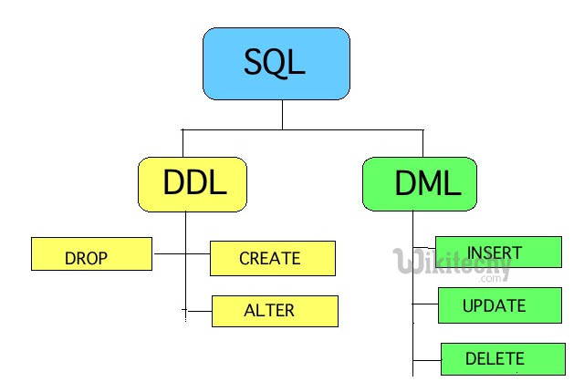
Tel: 01017776756 - 01501827070
E-mail: sherrost@yahoo.com
section 8 – DBMS
AS - 258
THE DATABASE MANAGEMENT SYSTEM (DBMS)
Data Definition Language (DDL)
CREATE DATABASE BandBooking;
CREATE TABLE Band (BandName varchar(25), NumberOfMembers integer);
ALTER TABLE Band ADD PRIMARY KEY (BandName);
ALTER TABLE Band-Booking ADD FOREIGN KEY (BandName REFERENCES Band(BandName);
These examples show that once the database has been created, the tables can be created and the attributes defined.
It is possible to define a primary key and a foreign key within the CREATE TABLE command but the ALTER TABLE command can be used as shown (it can also be used to add extra attributes).
When an attribute is defined, its data type must be specified.
As with procedural languages there can be different data types or different names for data types depending on which DBMS is being used.
One feature common to all databases is that the number of characters allowed for an attribute can be defined by including the number in brackets.
In the above example BandName varchar(25) allows up to 25 characters for the band name.

Slide 3
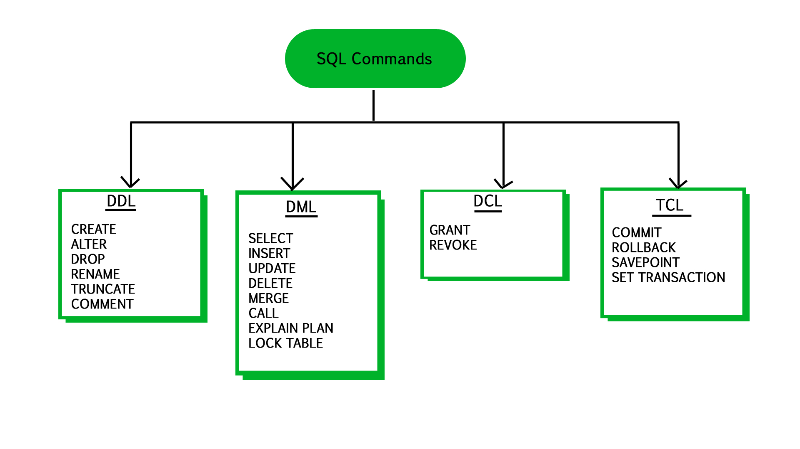
Tel: 01017776756 - 01501827070
E-mail: sherrost@yahoo.com
section 8 – DBMS
AS - 259
THE DATABASE MANAGEMENT SYSTEM (DBMS)
Data Manipulation Language (DML)
There are three categories of use for Data Manipulation Language (DML)
The insertion of data into the tables when the database is created
The modification or removal of data in the database
The reading of data stored in the database
The following illustrate the two possible ways that SQL can be written to populate a table with data:
INSERT INTO Band (‘ComputerKidz’, 5);
INSERT INTO Band-Booking (BandName, BookingID)
VALUES (‘ComputerKidz’, ‘2016/023’);
The first example shows a simpler version that can be used if the order of the attributes is known.
The second shows the safer method; the attributes are defined then the values are listed.
There are some points to note
Parentheses are used in both versions.
A separate INSERT command has to be used for each tuple in the table.
There is an order defined for the attributes.
Although the SQL will have a list of INSERT commands the subsequent use of the table has no concept of the tuples being ordered.

Slide 4
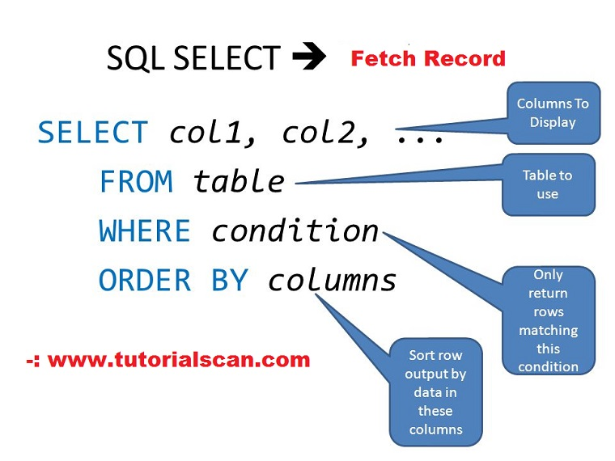
Tel: 01017776756 - 01501827070
E-mail: sherrost@yahoo.com
section 8 – DBMS
AS - 260
THE DATABASE MANAGEMENT SYSTEM (DBMS)
Data Manipulation Language (DML)
The main use of DML is to obtain data from a database using a query.
A query always starts with the SELECT command.
Two examples are:
The simplest form for a query has the attributes for which values are to be listed as output identified after SELECT and the table name identified after FROM.
For example:
SELECT BandName FROM Band;
Note that the components of the query are separated by spaces.
The Band table only has two attributes.
To list the values for both there are two options:
SELECT BandName, NumberOfMembers
FROM Band;
OR
SELECT * FROM Band;
which uses * to indicate all attributes.
Note that in the first example the attributes are separated by commas but no parentheses are needed.

Slide 5
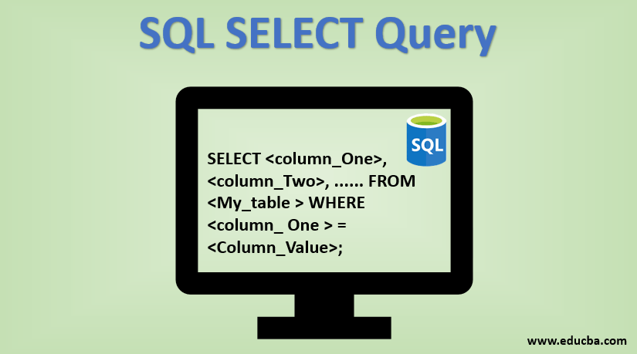
Tel: 01017776756 - 01501827070
E-mail: sherrost@yahoo.com
section 8 – DBMS
AS - 261
THE DATABASE MANAGEMENT SYSTEM (DBMS)
Data Manipulation Language (DML)
It is possible to include instructions in the SQL to control the presentation of the output.
The following uses ORDER BY to ensure that the output is sorted to show the data with the band names in alphabetical order.
SELECT BandName, NumberOfMembers
FROM Band
ORDER BY BandName;
In this query there is no question of duplicate entries because BandName is the primary key of the BandName table.
However, in the Band-Booking table an individual value for BandName will occur many times.
If a query were being used to find which bands already had a booking there would be repeated names in the output.
This can be prevented by the use of GROUP BY as shown here:
SELECT BandName
FROM Band-Booking
GROUP BY BandName;
An extension of the control of the output from a query is to include a condition to limit the selected data.
This is provided by a WHERE clause.
The following are examples:
SELECT BandName
FROM Band-Booking
WHERE Headlining = ‘Y’
GROUP BY BandName;
which produces a single output for each band that has headlined.

Slide 6
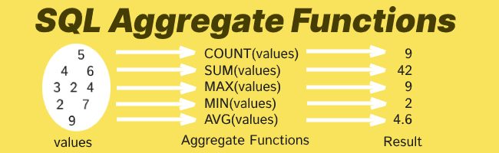
Tel: 01017776756 - 01501827070
E-mail: sherrost@yahoo.com
section 8 – DBMS
AS - 262
THE DATABASE MANAGEMENT SYSTEM (DBMS)
Data Manipulation Language (DML)
It is possible to qualify the SELECT statement by using a function.
SUM, COUNT and AVG are examples of functions that work on data held in several tuples for a particular attribute and return one value.
For this reason, these functions are called aggregate functions.
As an example, the following code displays the number of members in a band:
SELECT Count(*)
FROM Band;
This is a special case because there is no need to specify the attribute.
An example using a specific attribute would be:
SELECT AVG (NumberOfMembers)
FROM Band;
OR
SELECT SUM (NumberOfMembers)
FROM Band;

Slide 7
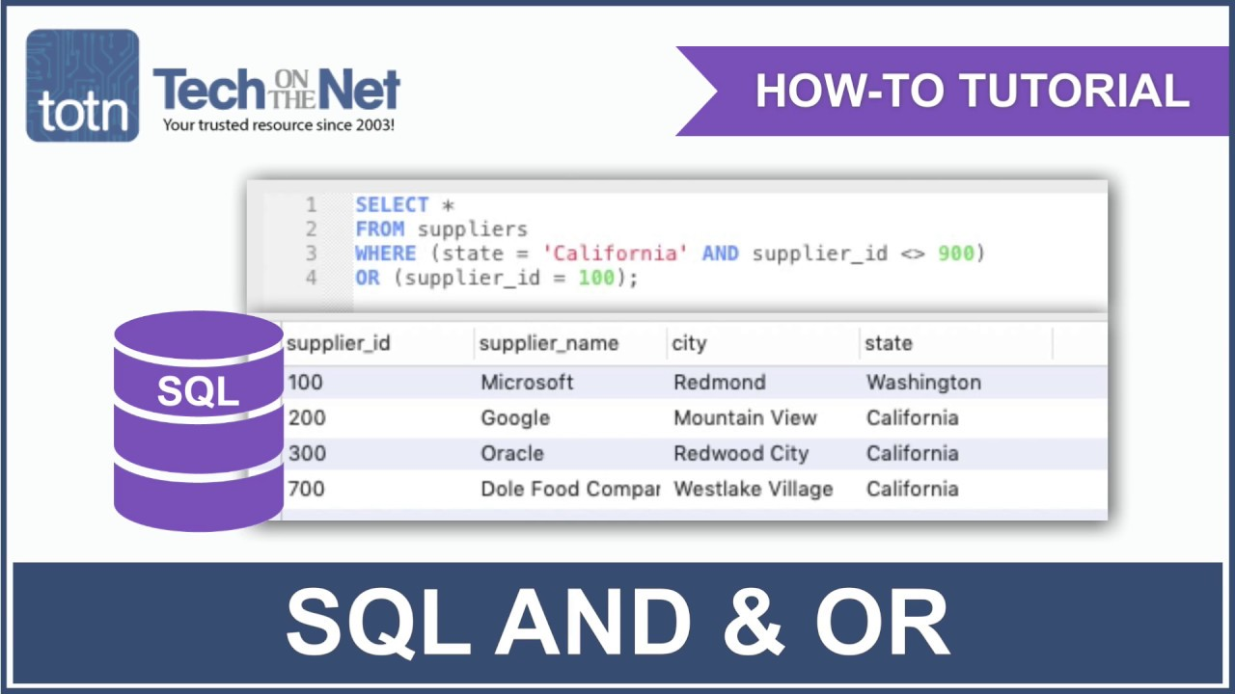
Tel: 01017776756 - 01501827070
E-mail: sherrost@yahoo.com
section 8 – DBMS
AS - 263
THE DATABASE MANAGEMENT SYSTEM (DBMS)
Data Manipulation Language (DML)
A query can be based on a ‘join condition’ between data in two tables.
The most frequently used is an inner join which is illustrated by:
SELECT VenueName, Date
FROM Booking
WHERE Band-Booking.BookingID = Booking.BookingID
AND Band-Booking.BandName = ‘ComputerKidz’;
The SQL uses the full definitive name for each attribute with the table name and attribute name separated by a dot.
The query contains two conditions.
The way that the query works is as follows.
The Band-Booking table is searched for instances where the BandName is ComputerKidz.
For each instance the BookingID is noted.
Then there is a search of the Booking table to find the examples of tuples having this value for BookingID.
For each one found the VenueName and Date are presented in the output.

Slide 8
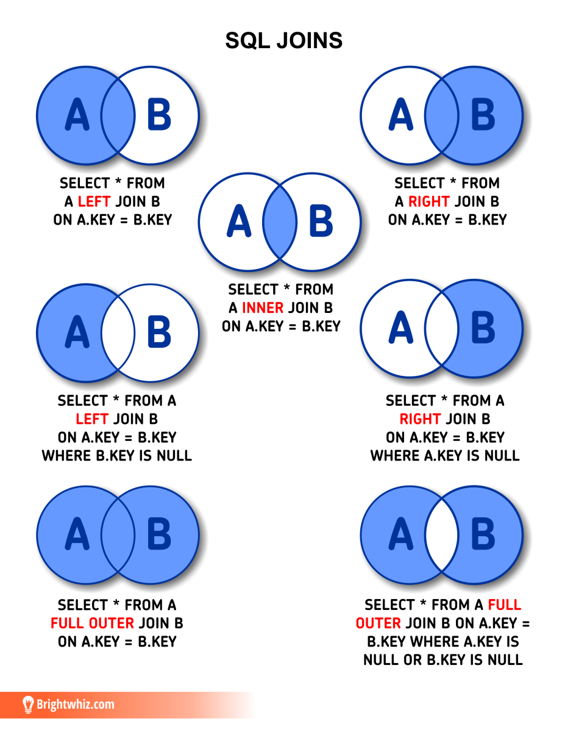

Tel: 01017776756 - 01501827070
E-mail: sherrost@yahoo.com
section 8 – DBMS
AS - 264
THE DATABASE MANAGEMENT SYSTEM (DBMS)
Data Manipulation Language (DML)
Some versions of SQL require the explicit use of INNER JOIN.
The following is a possible generic syntax:
SELECT table1.column1, table2.column2...
FROM table1
INNER JOIN table2
ON table1.common _ field = table2.common _ field;
The other use of DML is to modify the data stored in the database.
The UPDATE command is used to change the data.
If the band ComputerKidz recruited an extra member the following SQL would make the change needed.
UPDATE Band
SET NumberOfMembers = 6
WHERE BandName = ‘ComputerKidz’;
Note the use of the WHERE clause.
If you forgot to include this the UPDATE command would change the number of band members to 6 for all of the bands.

Slide 9

Tel: 01017776756 - 01501827070
E-mail: sherrost@yahoo.com
section 8 – DBMS
AS - 265
THE DATABASE MANAGEMENT SYSTEM (DBMS)
Data Manipulation Language (DML)
The DELETE command is used to remove data from the database.
This has to be done with care.
If the ITWizz band decided to disband the following SQL would remove the name from the database.
DELETE FROM Band-Booking
WHERE BandName = ‘ITWizz’;
DELETE FROM Band
WHERE BandName = ‘ITWizz’;
Note that if an attempt was made to carry out the deletion from Band first there would be an error.
This is because BandName is a foreign key in Band-Booking.
Any entry for BandName in Band-Booking must have a corresponding value in Band.
END OF SECTION 8
END OF PAPER 1

